Slide 1
PRESENTATION ON CLEANROOM SOFTWARE ENGINEERING BY
MELBOREEN WARBAH
ROLL NO 13
GROUP 4

Slide 2
CONTENTS
INTRODUCTION
DEFINATION
CLEANROOM STRATEGY
BOX STRUCTURE SPECIFICATION
--BLACK BOX
--STATE BOX
--CLEAR BOX
EXAMPLE OF BOX STRUCTURE SPECIFICATION
CLEANROOM DESIGN:DESIGN VERIFICATION
CORRECTNESS VERIFICATION
ADVANTAGES OF DESIGN VERIFICATION
REFERENCE

Slide 3
INTRODUCTION
The term ‘Cleanroom’ was derived from the semi-conductor industries. In the semiconductor industry, contaminant free environments called as cleanrooms are used to manufacture the silicon chips.
The main goal of the cleanroom software engineering is to develop zero-defect software which is similar to the cleanroom approach followed by the semi-conductor industries.
The cleanroom philosophy was first proposed for software engineering by Harlan Mills, Richard Linger and Michael Dyer from the 1960s through the 1980s.

Slide 4
DEFINITION
Cleanroom Software Engineering is an approach that emphasizes the need to build correctness into software as it is being developed .

Slide 5
CLEANROOM STRATEGY
The Cleanroom Process Model

Slide 6
CLEANROOM STRATEGY - PART 1
Increment planning.
The project plan is built around the incremental strategy.
Requirements gathering.
Customer requirements are elicited and refined for each increment using traditional methods.
Box structure specification.
Box structures isolate and separate the definition of behavior, data, and procedures at each level of refinement.

Slide 7
CLEANROOM STRATEGY - PART 2
Formal design.
Specifications (black-boxes) are iteratively refined to become architectural designs (state-boxes) and component-level designs (clear boxes).
Correctness verification.
Correctness questions are asked and answered, formal mathematical verification is used as required.

Slide 8
CLEANROOM STRATEGY - PART 3
Code generation, inspection, verification.
Box structures are translated into program language; inspections are used to ensure conformance of code and boxes, as well as syntactic correctness of code; followed by correctness verification of the code.
Statistical test planning.
A suite of test cases is created to match the probability distribution of the projected product usage pattern.

Slide 9
CLEANROOM STRATEGY - PART 4
Statistical use testing.
A statistical sample of all possible test cases is used rather than exhaustive testing.
Certification.
Once verification, inspection, and usage testing are complete and all defects removed, the increment is certified as ready for integration.

Slide 10
BOX STRUCTURED DESIGN
Box structures are used to systematically move from an abstract specification to a detailed design providing implementation detail.
Box structures model system components as abstractions in three increasingly detailed forms:
Black Box
Gives an external view of the component.
Provides description of functional requirements without details on the internal structure and operations.
Describes the user-visible system inputs and responses.

Slide 11
BOX STRUCTURED DESIGN
State Box
Gives an intermediate view of the component.
Decomposes the black box into an internal state representation and an internal black box.
Clear Box
Gives a detailed view of the component.
Replaces the internal black box with a detailed design using structured programming constructs.

Slide 12
BOX STRUCTURED DEVELOPMENT
The refinement approach using box structure specification

Slide 13
BLACK BOX
f:S*→R
S
R
Specifies system function by mapping all possible stimulus histories to all possible responses
S* → R
stimulus history → responses

Slide 14
STATE BOX
State
T
The state is the encapsulation of the stimulus history
State variables are invented to save any stimuli that need to retained
g:S* x T* → R x T
stimuli X state data → responses X state data
Black box,g
S
R

Slide 15
CLEAR BOX
Clear Box
State
Black Box
Black Box
S
R
Specifies both data flow and control flow
S x T → R x T
stimuli X state data → responses X state data
State update and response production is allowed

Slide 16
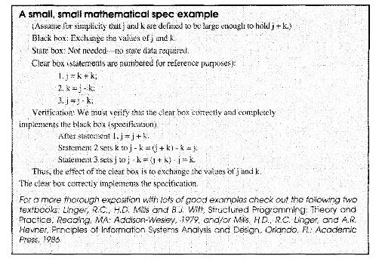
EXAMPLE

Slide 17
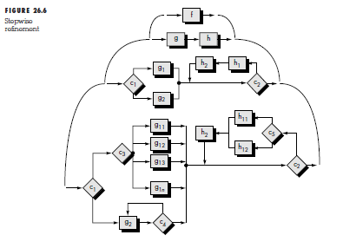
CLEANROOM DESIGN:DESIGN REFINEMENT AND VERIFCATION

Slide 18
CLEANROOM DESIGN:DESIGN REFINEMENT AND VERIFCATION
A program function,f,is refined into a sequence of sub-function g and h.
These in turn are refined into conditional constructs(if-then-else and do-while) .
At each level of refinement, the cleanroom team performs a formal correctness verification.
to accomplish this, a set of generic correctness conditions are attached to the structured programming consructs.

Slide 19
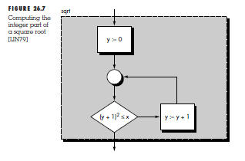
CORRECTNESS VERIFICATION

Slide 20
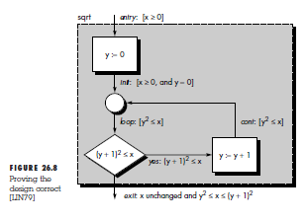
CORRECTNESS VERIFICATION(Contd…)

Slide 21
CORRECTNESS VERIFICATION(Contd…)
To verify the correctness of this design, we must define entry and exit conditions.
The entry condition notes that x must be greater than or equal to 0.
The exit condition requires that x remain unchanged and take on a value within the range.
To prove the design to be correct, it is necessary to prove the conditions init, loop, cont, yes, and exit are true in all cases.
These are sometimes called subproofs.

Slide 22
CORRECTNESS VERIFICATION(Contd…)
1. The condition init demands that [x ≥ 0 and y = 0]. Based on the requirements of the problem, the entry condition is assumed correct. Therefore, the first part of the init condition, x ≥ 0, is satisfied. Referring to the flowchart, the statement immediately preceding the init condition, sets y = 0. Therefore, the second part of the init condition is also satisfied. Hence, init is true.
2. The loop condition may be encountered in one of two ways: (1)directly from init (in this case, the loop condition is satisfied directly) or via control flow that passes through the condition cont. Since the cont condition is identical to the loop condition, loop is true regardless of the flow path that leads to it.

Slide 23
CORRECTNESS VERIFICATION(Contd…)
3. The cont condition is encountered only after the value of y is incremented by 1. In addition, the control flow path that leads to cont can be invoked only if the yes condition is also true. Hence, if (y + 1)2 ≤ x, it follows that y2 ≤ x. The cont condition is satisfied.
4. The yes condition is tested in the conditional logicshown. Hence, the yes condition must be true when control flow moves along the path shown.

Slide 24
CORRECTNESS VERIFICATION(Contd…)
5. The exit condition first demands that x remain unchanged. An examination of the design indicates that x appears nowhere to the left of an assignment operator. There are no function calls that use x. Hence, it is unchanged. Since the conditional test (y + 1)2 ≤ x must fail to reach the exit condition, it follows that (y + 1)2 ≤ x. In addition, the loop condition must still be true (i.e., y2 ≤ x). Therefore, (y + 1)2 > x and y2 ≤ x can be combined to satisfy the exit condition.

Slide 25
DESIGN VERIFICATION ADVANTAGES
Reduces verification to a finite process
Improves quality
Lets cleanroom teams verify every line of design and code
Results in near zero levels of defects
Scales up to larger systems and higher levels
Produces better code than unit testing

Slide 26
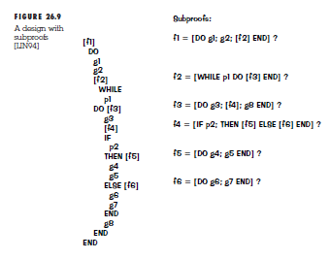
EXAMPLES

Slide 27
REFERENCES
Software Engineering
A P R A C T I T I O N E R ’ S A P P R O A C H
FIFTH EDITION
Roger S. Pressman, Ph.D.
https://www.cs.umd.edu
http://www.star.cc.gatech.edu

Slide 28
THANK
YOU

